Slide 1


MM-de
03/2023

Slide 2

Outline
Executive Summary
Introduction
Methodology
Results
Conclusion
Appendix

Slide 3
Executive Summary
This capstone project will analyse, if the SpaceX Falcon 9 first stage will land successfully using data science methods and classification algorithms.
The analysis is divided into the following main steps:
Data collection, wrangling, and formatting
Exploratory data analysis
Interactive data visualization
Machine learning prediction
The analysis shows, that correlations between certain features of the rocket launches and the outcome of the rocket launches are visible.
The most suitable machine learning algorithm to to predict if the Falcon 9 first stage landing is the decision tree model.

Slide 4
Introduction
This capstone project has the target to predict, if the Falcon 9 first stage will land successfully and which criteria's have an influence on the successful landing.
The customer is a competitor of SpaceX, who advertises that a Falcon 9 rocket launches with a cost of 62 million dollars. Other providers cost up to 165 million dollars per start. The price saving of SpaceX result of the reuse of the first rocket stage.
Most unsuccessful landings are planned. Sometimes, SpaceX will perform a controlled landing in the ocean.
The main question that we are trying to answer is, for a given set of features about a Falcon 9 rocket launch which include among others the payload mass, orbit type, launch site, will the first stage of the rocket land successfully.

Slide 5

Section 1

Slide 6
Methodology
Executive Summary
Data collection methodology and data wrangling:
Data collection, wrangling, formatting with SpaceX API and Web scraping
Perform exploratory data analysis (EDA) using visualization and SQL
Visualization using scatter plots / bar graphs and analysis using SQL queries
Perform interactive visual analytics using Folium and Plotly Dash
Visualization of payload and successful launches
Perform predictive analysis using classification models
Machine learning with logistic regression, SVM, decision trees and KNN

Slide 7
Data Collection
Data collection from SpaceX REST API about rocket launches https://api.spacexdata.com/v4 Data collected:
FlightNumber, Date, BoosterVersion, PayloadMass, Orbit, LaunchSite, Outcome, Flights, GridFins, Reused, Legs, landingPad, Block, ReusedCount, Serial, Longitude, Latitude
Data collection from Wikipedia via Web Scraping https://en.wikipedia.org/w/index.php?title=List_of_Falcon_9_and_Falcon_Heavy_launches&oldid=1027686922
Data collected:
Flight No,, Launch site, Payload, PayloadMass, Orbit, Customer, Launch outcome, Version Booster, Booster landing, Date, Time
Data Collection from SpaceX API
Decoding and tranformation into pandas dataframe
Request required data
Store data in dictionary and transformation to dataframe
Filtering for Falcon 9 launches
Replacing missing values of PayloadMass with mean
Exporting data to .csv

Slide 8
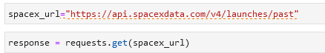
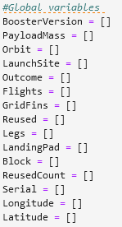
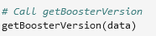
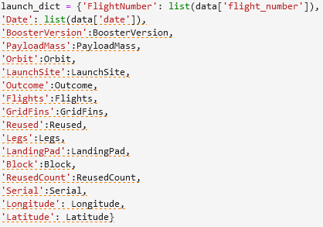
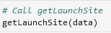
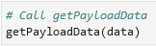
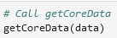
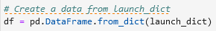
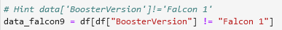
Data Collection – SpaceX API
Data collection based on SpaceX API to get data about launches, including information about the rocket used, payload delivered, launch specifications, landing specifications and landing outcome.
1: - Make a GET response to the SpaceX REST API - Convert the response to a .json file then to a Pandas DataFrame
2: - Data cleaning - Create and define lists for the data storage - Extract data and write data to predefined lists - Setup a dictionary and create a dataset
3: - Transform dataset to a Panday Dataframe for further analysis
4: - Filter the DataFrame for Falcon 9 launches - Reset FlightNumber column in dataset - Replace the NaN values of PayloadMass with the mean values
5: - Result: We end up with 90 rows and 17 columns. Extract of the data:
Link - Github

Slide 9
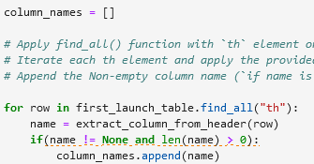
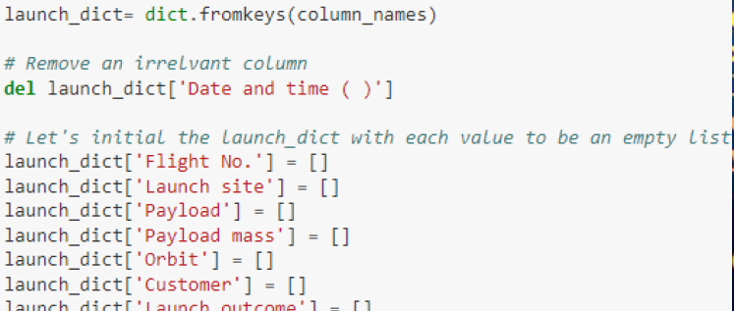
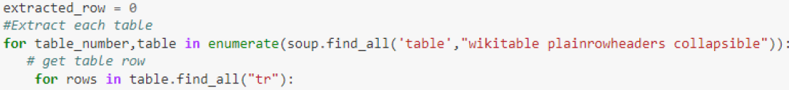
Data Collection - Scraping
1: - Get response from HTML and create Soup object
2: - Find tables
3: - Extract column names
4: - Create launch data dictionary
5: - Extract table data to dictionary
6: - Create dataframe from dictionary
7: - Export to .csv
Data collection about Falcon 9 launches from Wikipedia
Creating BeautifulSoup object
Extracting column headers from HTML table
Collecting required data
Create dictionary with required data
Transformation to dataframe
Exporting to .csv

Slide 10
Data Wrangling
Analysis was performed on the data.
Success rates for different launch sites, orbits, payloads and throughout the years.
Finally, a result column was created that held the information about the success and failure of the launch.

Slide 11
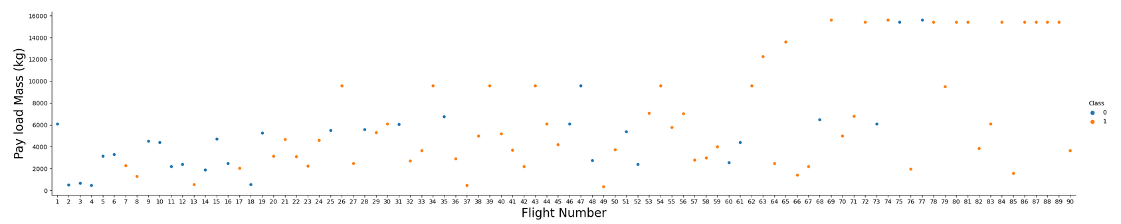
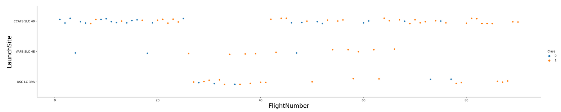
EDA with Data Visualization
Exploration was performed using bar plots, scatter plots for understanding the relations between pairs of features.
The pairs of features were Launch Site and Payload, success rate and Orbit Types, Orbit Types and Flight Numbers etc. (Examples shown below)

Slide 12
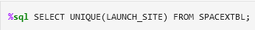
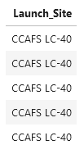
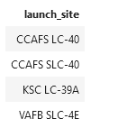
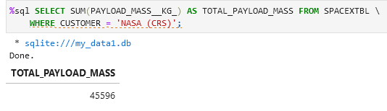
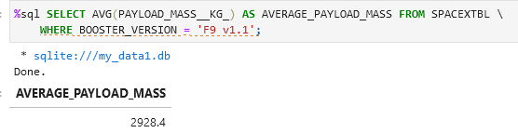
EDA with SQL
Exploration on the data was also done using SQL. Following queries were performed:
The names of the unique launch sites.
5 launch sites that begin with the string 'CCA'.
Total payload mass carried by boosters launched by NASA (CRS).
Average payload mass carried by booster version F9 v1.1.
Date of the first successful landing outcome in ground pad.
Successful boosters in drone ship that have payload mass between 4000 and 6000.
Total number of successful and failure mission outcomes.
Names of the booster versions which have carried the maximum payload mass.
Failure for drone ship ,booster versions, launch site and months for the months in year 2015.
Rank the count of successful landing outcomes between the date 04-06-2010 and 20-03-2017 in descending order.

Slide 13
Build an Interactive Map with Folium
Folium maps with Circles, Markers, MarkerClusters, MousePositions were generated.
Circles are used to highlight areas surrounding the launch sites like Cape Canaveral Space Launch Complex 40 (CCAFS LC-40).
Markers are used to mark the co-ordinates of the launch sites.
Mouse Positions were used to calculate the co-ordinates of the location the mouse is pointing to on the map.
Lines were used to display the distance between the launch sites and other locations such as railways, coastlines and cities etc.

Slide 14
Build a Dashboard with Plotly Dash
Graphs were displayed on an Interactive UI to visualize the data.
Pie chart to display the success and failure rate of a selected Launch Site.
Payload range slider to select the launches in the specified range of payloads to analyze.
The dashboard allows effortless analysis of the relation between payload ranges, launch sites and their success and failure rates.

Slide 15
Predictive Analysis (Classification)
Built ML models to train on the data for prediction of launch success or failure.
Decision Tree
Logistic Regression.
Support Vector Machines
K Nearest Neighbors.
The data was standardized and split into training and testing sets.
Hyper-parameter optimization was done on the models to find the best parameters for the models.
The accuracy scores of the models were compared to select the best one.

Slide 16
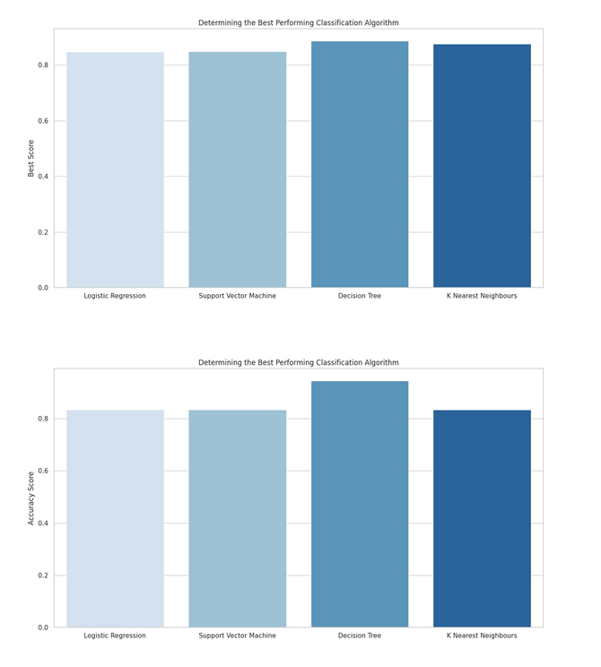
Results
SpaceX uses 4 different launch sites. CCAFS LC-40, VAFB SLC-4E, KSC LC-39A, CCAFS SLC-40.
The average payload of F9 v1.1 booster is 2,928.4 kg.
The total payload of NASA Boosters is 45,596 kg.
The first successful ground pad landing was done on 1st May 2017.
Only 1 in-flight launch resulted in failure. Rest all were a success.
Only 2 drone ship failures were reported in the F9 v1.1 B1012 and F9 v1.1 B1015 boosters.
The success rate for the launches have increased over the years after the year 2013.
Interactive folium maps showed that most of the successful launches were near the coastlines away from cities in safety locations.
These locations also have sophisticated infrastructure such as railways.
The predictive analysis revealed that the Decision Tree is the best model for the predictions as it had the highest accuracy score.

Slide 17

Section 2

Slide 18
Flight Number vs. Launch Site
The CCAFS SLC 40 has the highest success rate.
The success rates improved with more launches performed.

Slide 19
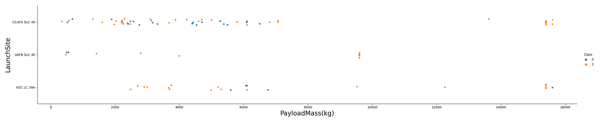
Payload vs. Launch Site
Higher Payload launches have a higher success rate.
Most Launches have Payload Masses below 6000 kg

Slide 20
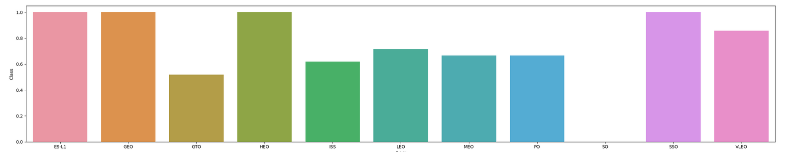
Success Rate vs. Orbit Type
ES-L1, GEO, HEO and SS0 have the highest success rate for launches
SO orbit has 0 success rate.

Slide 21
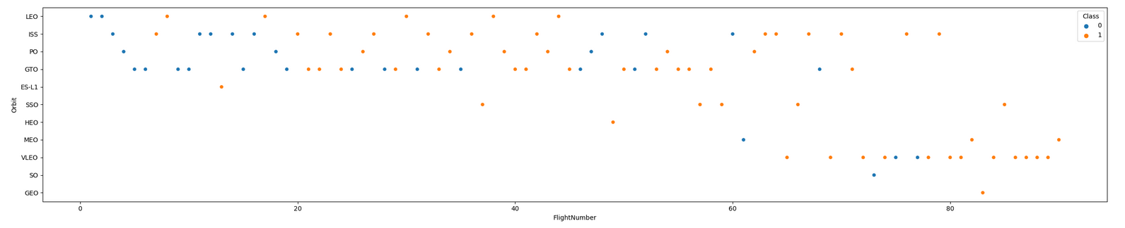
Flight Number vs. Orbit Type
An increased success rate increases success rate is observed for all the orbits.
SSO and VLEO orbits are used for later launches and have a promising success rate.

Slide 22
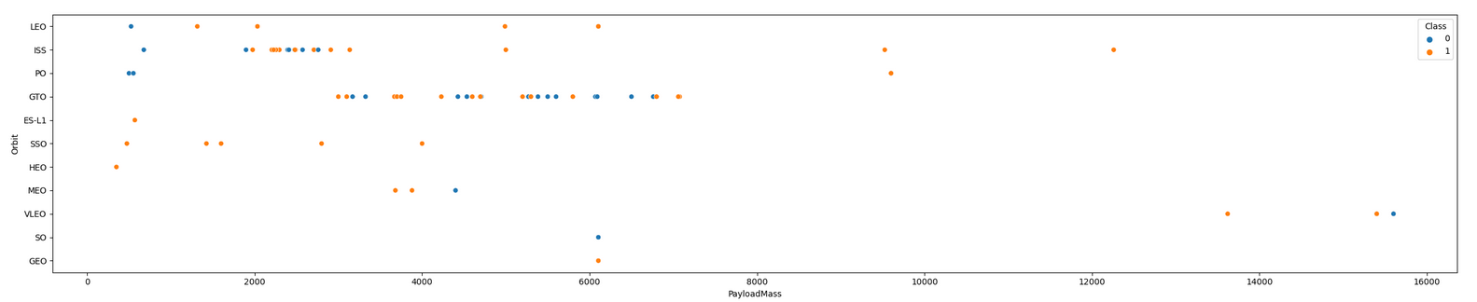
Payload vs. Orbit Type
With heavy payloads the success rate are more for PO, LEO and ISS orbits.
For GTO the successful and unsuccessful launches do not show a significant pattern.

Slide 23
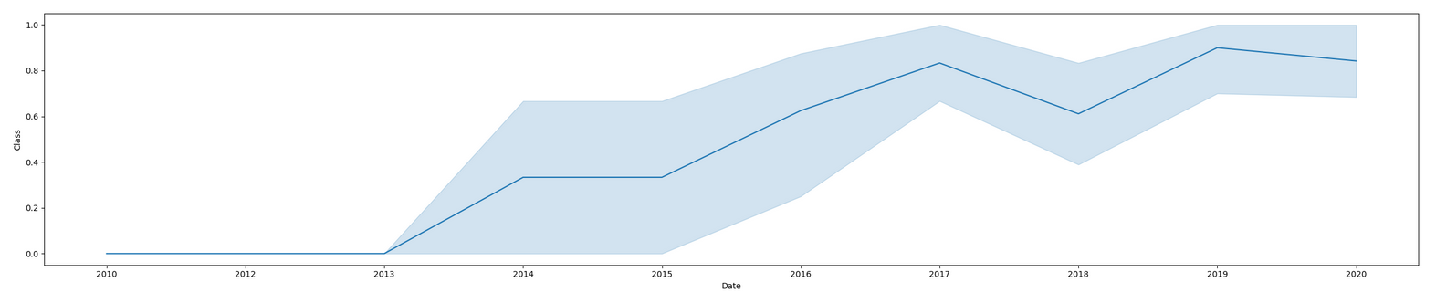
Launch Success Yearly Trend
The success rate clearly has improved over the years after the year 2013.
The success rate increased to approx. 80%.

Slide 24
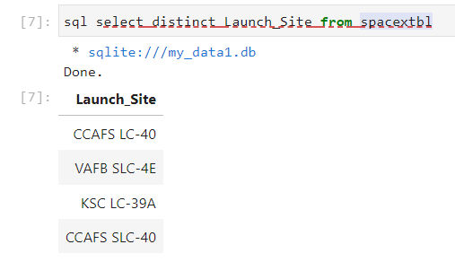
All Launch Site Names
The unique launch sites are.

Slide 25
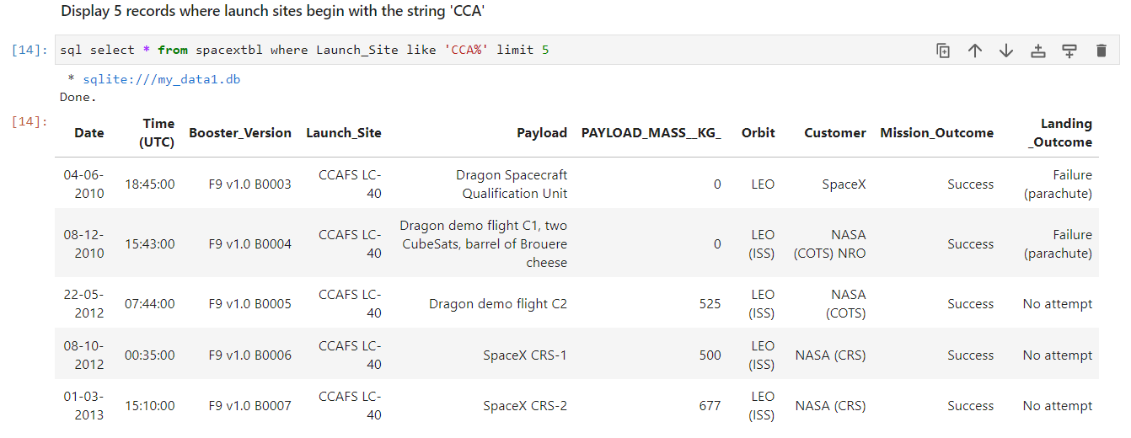
Launch Site Names Begin with 'CCA'
The launch missions for which the launch site name begins with "CCA".

Slide 26
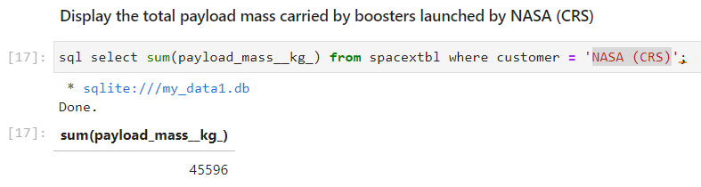
Total Payload Mass
Total payload carried by boosters launched by NASA.

Slide 27
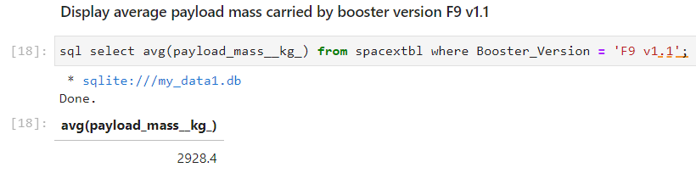
Average Payload Mass by F9 v1.1
Average payload carried by boosters version F9 v1.1.

Slide 28
First Successful Ground Landing Date
Date of first successful launch for ground pad.
01.05.2017

Slide 29
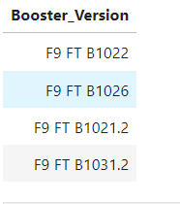
Successful Drone Ship Landing with Payload between 4000 and 6000
Names of boosters successful in drone ship with payload mass between 4000 and 6000 kg.

Slide 30
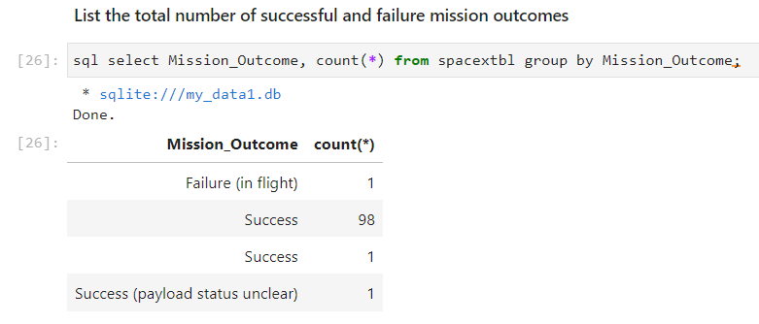
Total Number of Successful and Failure Mission Outcomes
Total number of successful and failed launches.

Slide 31
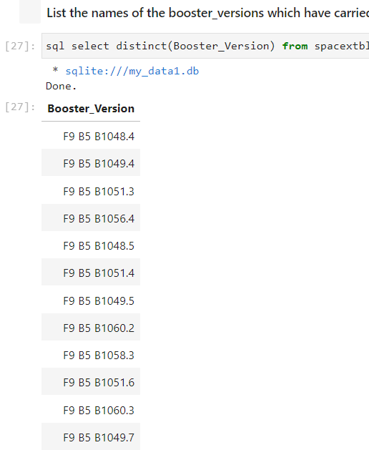
Boosters Carried Maximum Payload
Booster versions with highest payload mass.

Slide 32
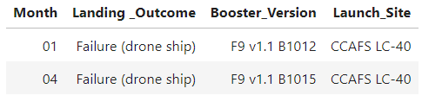
2015 Launch Records
Failed landing outcomes in drone ship in year 2015.

Slide 33
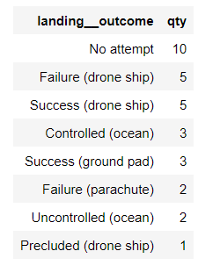
Rank Landing Outcomes Between 2010-06-04 and 2017-03-20
Rank the count of successful landing_outcomes between the date 04-06-2010 and 20-03-2017 in descending order.

Slide 34

Section 3

Slide 35
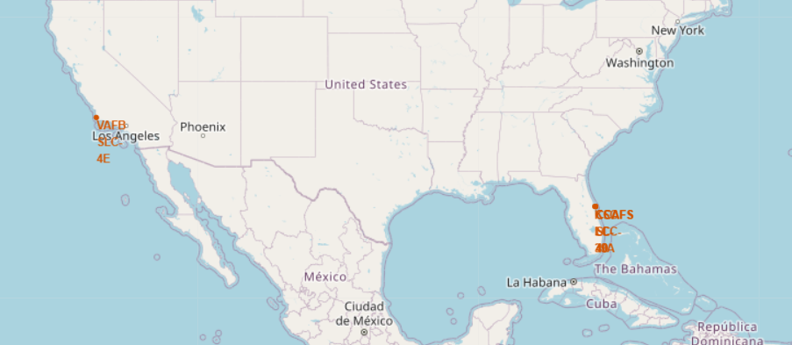
All Launch Sites on the Map
All the launch sites are away from the populated areas (cities) near the coastlines but close enough to sophisticated infrastructure like railways.

Slide 36
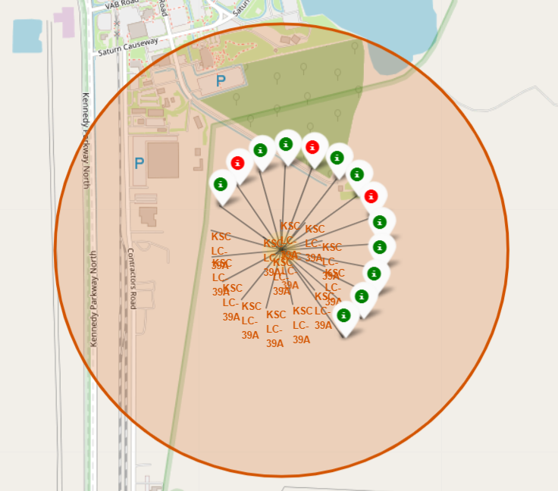
Launch Outcomes for each Site
This shows the KSC LC-39A launch site.
The green and red markers denote the successful and failed launch missions respectively.

Slide 37
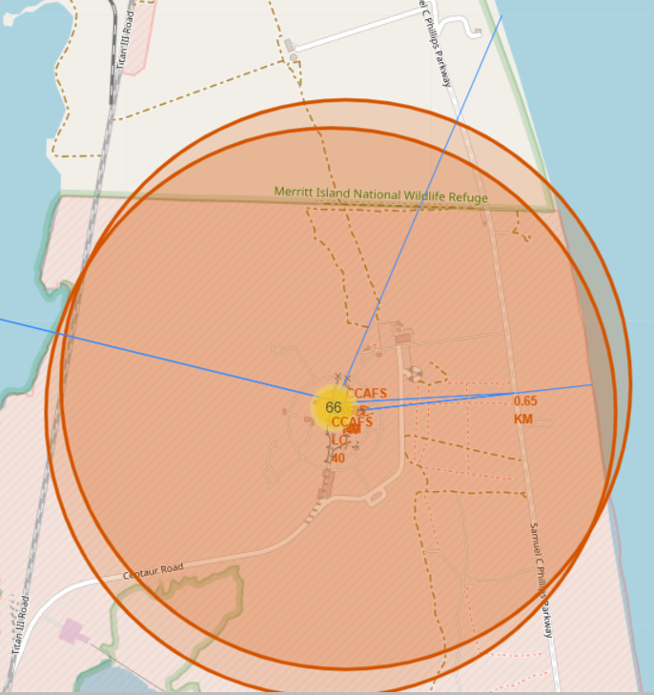
Infrastructure and Safety
Launch sites have a sophisticated infrastructure as they have good railways and roads in the vicinity.
The sites are also far away from the populated cities thus ensuring safety.

Slide 38

Section 4

Slide 39
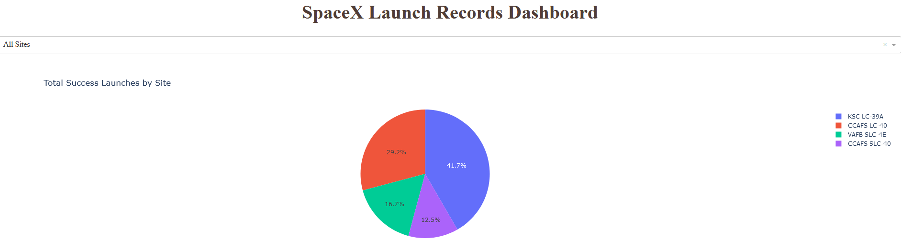
Successful Launches by Launch Site
The launch sites is an important factor affecting the success of the launch mission.

Slide 40
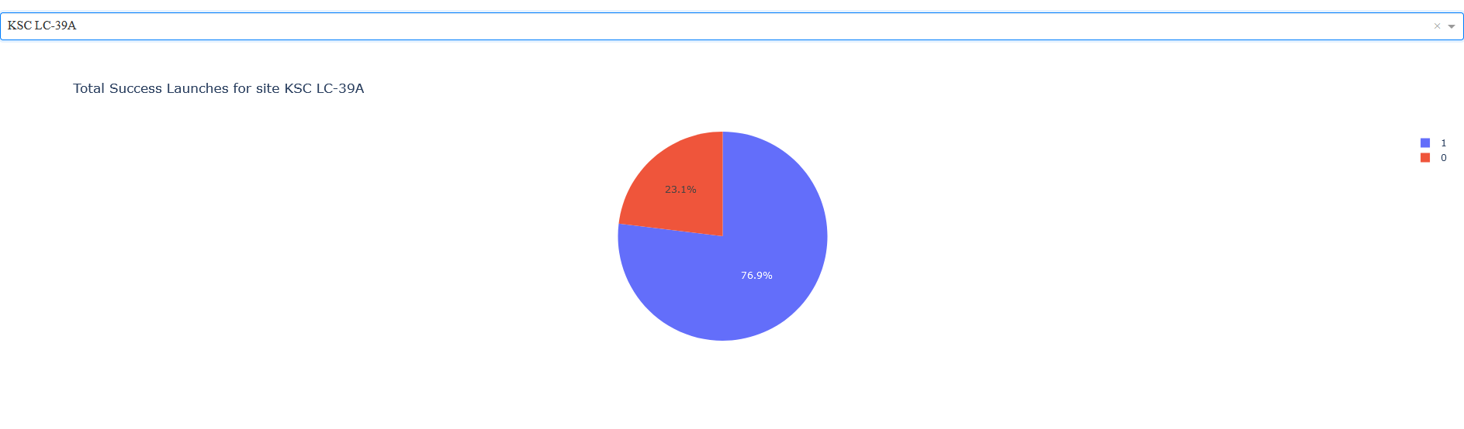
Success Rrate for KSC LC 39A
KSC LC 39A site reports 76,9 % success in all of its mission launches.

Slide 41
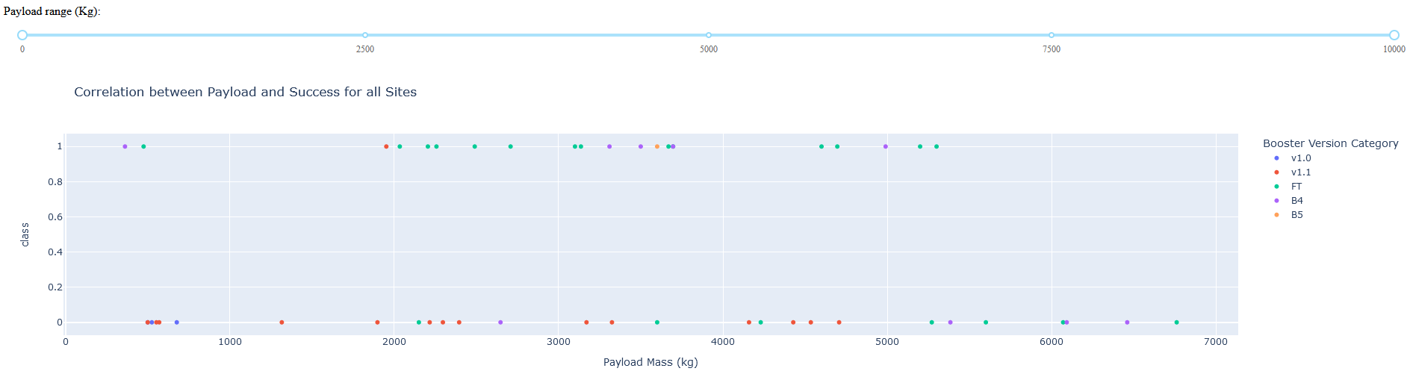
Payload and Launch Outcome Relation
Payloads in the range of 3000 to 6000 kg for v1.1 booster result in failures for all launch missions.

Slide 42

Section 5

Slide 43
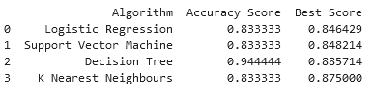
Classification Accuracy
Four classification models were used.
Logistic Regression
Support Vector Machines
Decision Trees.
K Nearest Neighbors
The validation accuracy of the Decision Tree model was the highest with 94%

Slide 44
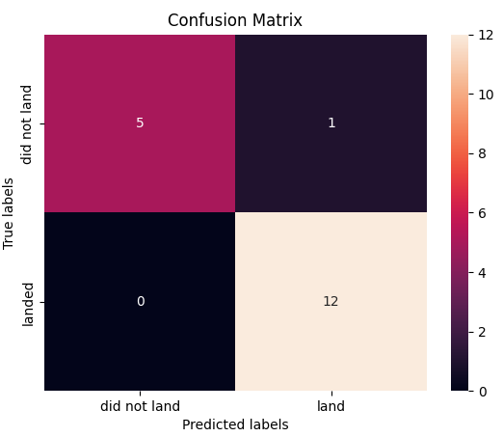
Confusion Matrix
The confusion matrix of the Decision Tree shows that the model performs more accurate in classification, than the other models.
The model correctly predicted 5 of 6 unsuccessful launches and 12 of 12 successful launches correct.

Slide 45
Conclusions
Most of the launch sites are located close to the coastline to prevent damage of critical infrastructure.
The launch site KSC LC-39A is the launch site with the highest success rate for launches.
The probability of successful launches has been improved since 2013.
The “Decision Tree Classifier Model” was the best model in predicting the success and failure of the launches.

Slide 46
Appendix
All the notebooks have been uploaded on GitHub – Results
Link

Slide 47


